Slide 1


Final Cooling with Thick Wedges for a Muon Collider
Daniel Fu, University of Chicago
Advisor: Karri DiPetrillo
4 December 2024

Slide 2
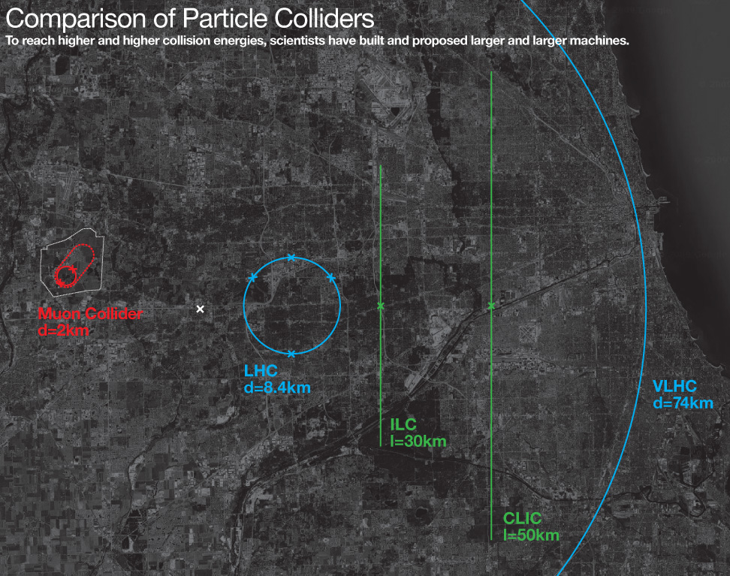
What is a Muon Collider?
Current particle accelerators use protons or electrons
Electrons lose energy to radiation – harder to reach high energy
Protons are composite particles – collisions inefficient and complex
Muons are high mass, elementary particles – best of both worlds
Potential to reach new energy scale (10+ TeV) with smaller footprint
Source: Fermilab

Slide 3
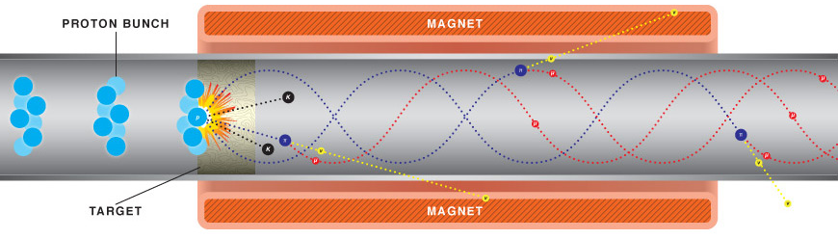
Muon production
Muons are unstable, must produce, accelerate, and collide them before they decay
Proton-target collisions produce pions, which decay into muons
Source: CERN

Slide 4
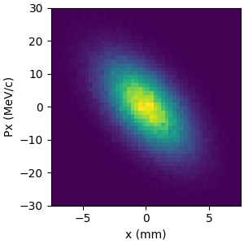
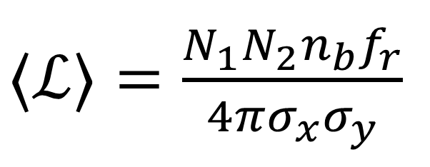
Emittance and Cooling
Emittance = area of distribution in phase-space
Initially high variance in muon position and momentum – measured by emittance
Emittance measured in longitudinal (parallel to beam) and transverse (perpendicular to beam) axes
Reducing emittance is important for maximizing luminosity; this process is known as cooling
$⟨ℒ⟩=\frac{N_{1}N_{2}n_{b}f_{r}}{4πσ_{x}σ_{y}}$
Variances in position related to transverse emittance

Slide 5
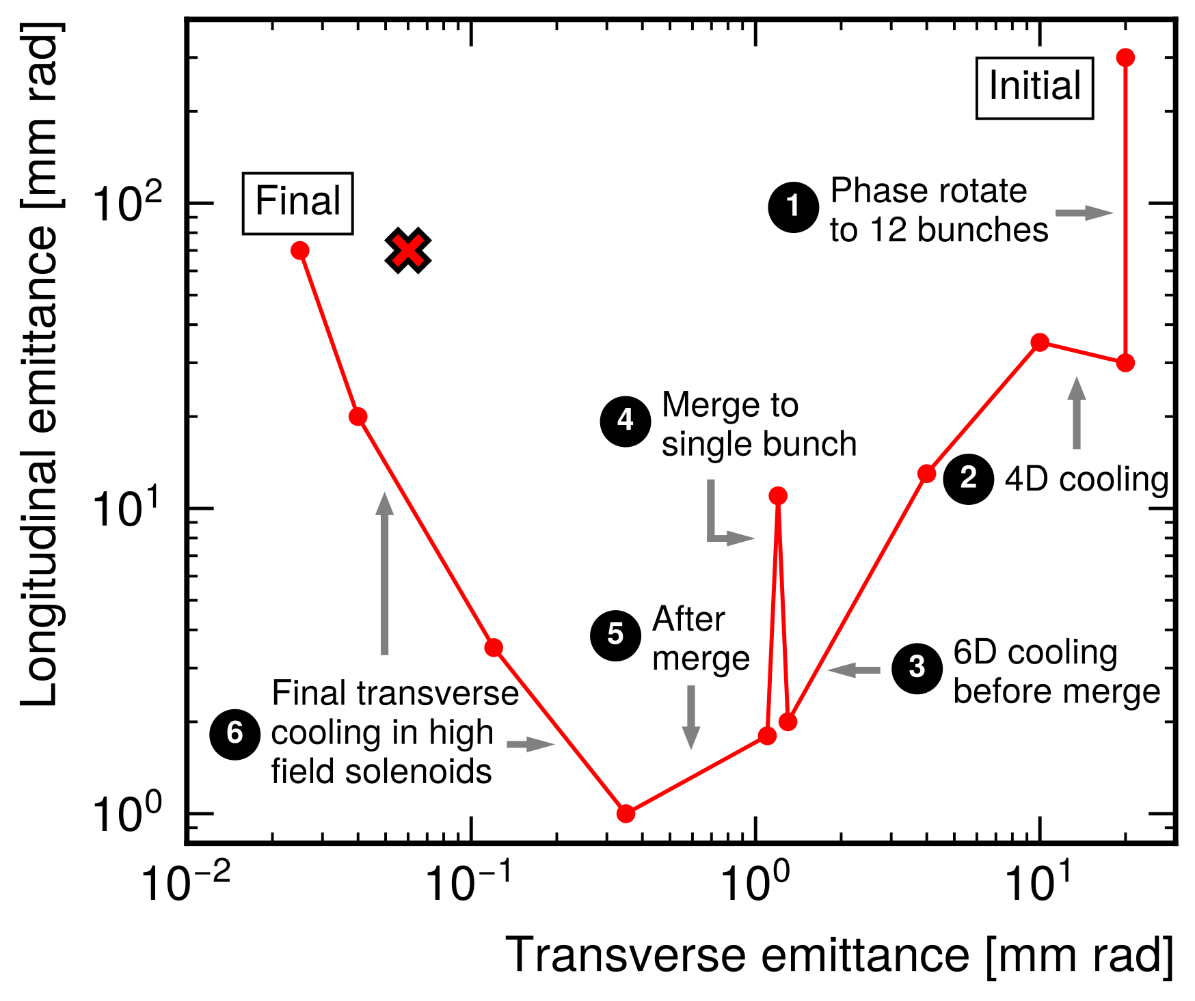
Final Cooling
Cooling occurs in several stages
Initial stages reduce emittance in all axes (6D cooling)
Final cooling reduces transverse emittance, longitudinal emittance allowed to grow (4D cooling)
Target emittance around 30 μm transverse, 100 mm longitudinal
I am studying this final cooling stage
Source: Fermilab

Slide 6
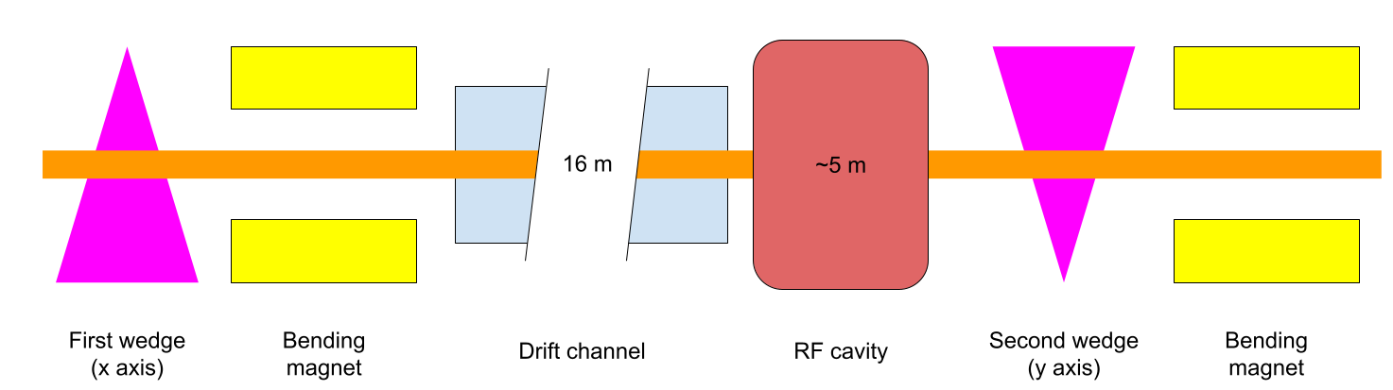
Final Cooling with Thick Wedges
Conceptual final cooling design proposed in 2016
Utilizes wedge-shaped absorbers to achieve emittance exchange
Lower magnetic field requirements than other methods

Slide 7
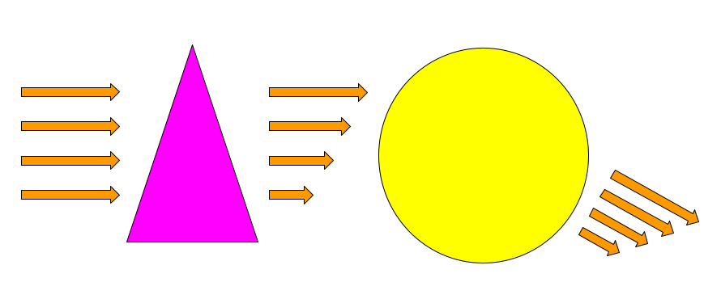
Wedge Cooling Mechanism
3. Bending magnet deflects particles by amount proportional to momentum
2. Muons encounter varying amounts of wedge material, thus decelerate by different amounts
1. Beam enters wedge absorber
4. Resulting beam has lower transverse emittance but higher spread in longitudinal momentum

Slide 8
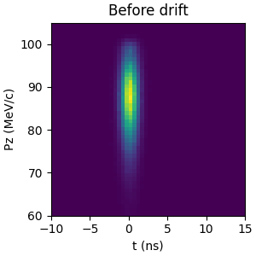
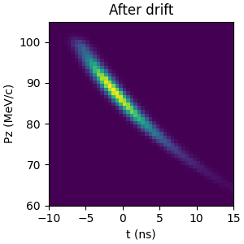
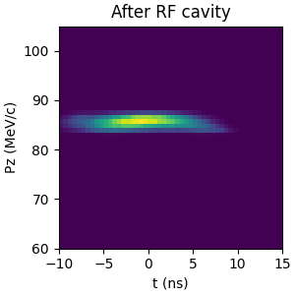
Phase Rotation
Particles travel through drift channel – correlation between z and Pz
RF cavity applies time-varying E-field – decelerates faster muons and accelerates slower muons
Decreases longitudinal momentum spread at the cost of increasing longitudinal position spread (longitudinal emittance unchanged)

Slide 9
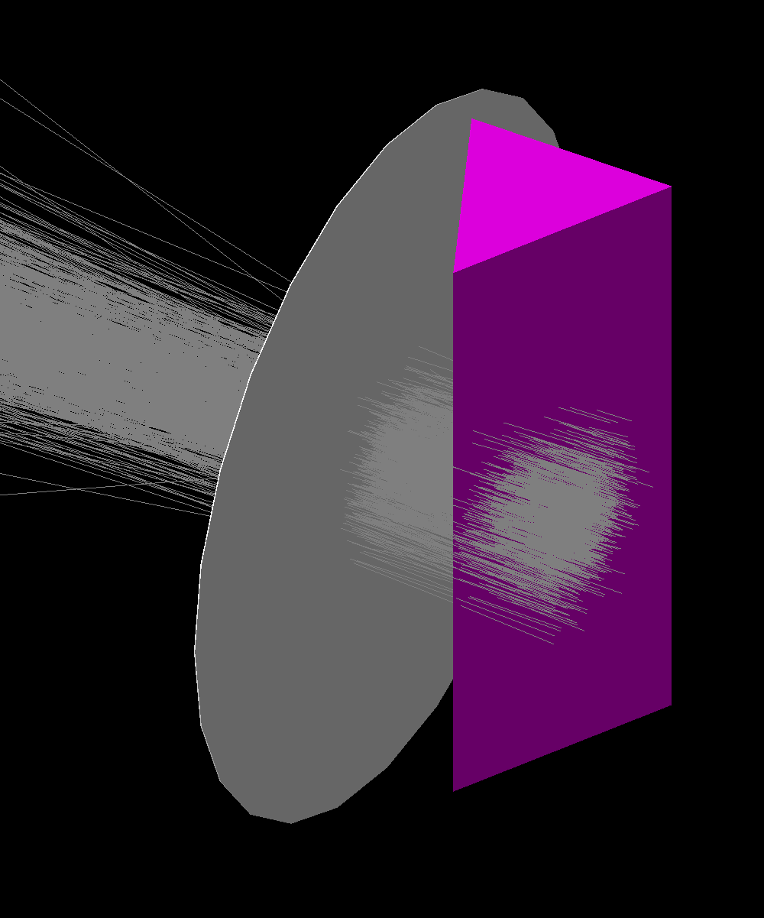
Prior work
I studied this method at Fermilab in Summer 2023
Used simulation software G4Beamline
Found that lower emittances can be achieved compared to other cooling methods proposed
Substantial assumptions made; portions left unmodeled
Unknown what magnetic fields would be required
Example G4Beamline simulation
Green: Modeled in summer 2023

Slide 10
Prior work
Continued working on this project through 2023-24 academic year
Added multiprocessing capability and evaluated simulation accuracy v.s. particle count and step size
Joined by Ryan Michaud, who modeled the drift channel in another particle simulation software, MAD-X, this summer
Green: Modeled in summer 2023
Blue: Modeled by Ryan in 2023-24

Slide 11
Goals of this project
Continue removing assumptions, working towards a full, end-to-end design for the wedge cooling channel
Design and optimize the bending magnets (dispersion correction) in MAD-X and/or G4Beamline
(If time) Design and optimize the focusing system for the RF cavity
Green: Modeled in summer 2023
Blue: Modeled by Ryan in 2023-24
Red: To be modeled in this work

Slide 12


Timeline
By end of December: Familiarize myself with MAD-X
By end of February: Model bending magnet section
By end of April: Model RF cavity focusing
Dr. Karri DiPetrillo
Ryan Michaud

Slide 13
Thank you for listening!
Questions?

Slide 14
Backup slides

Slide 15
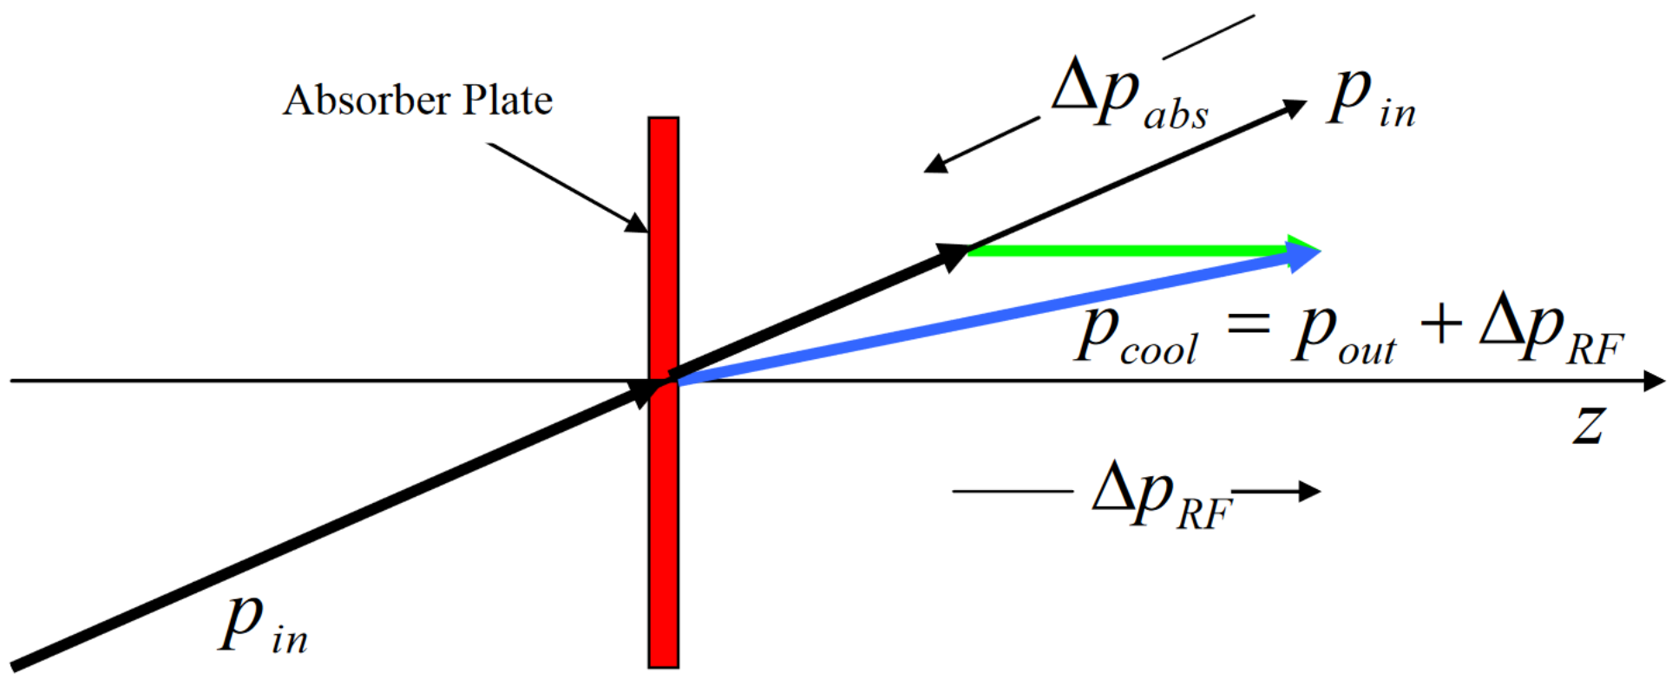
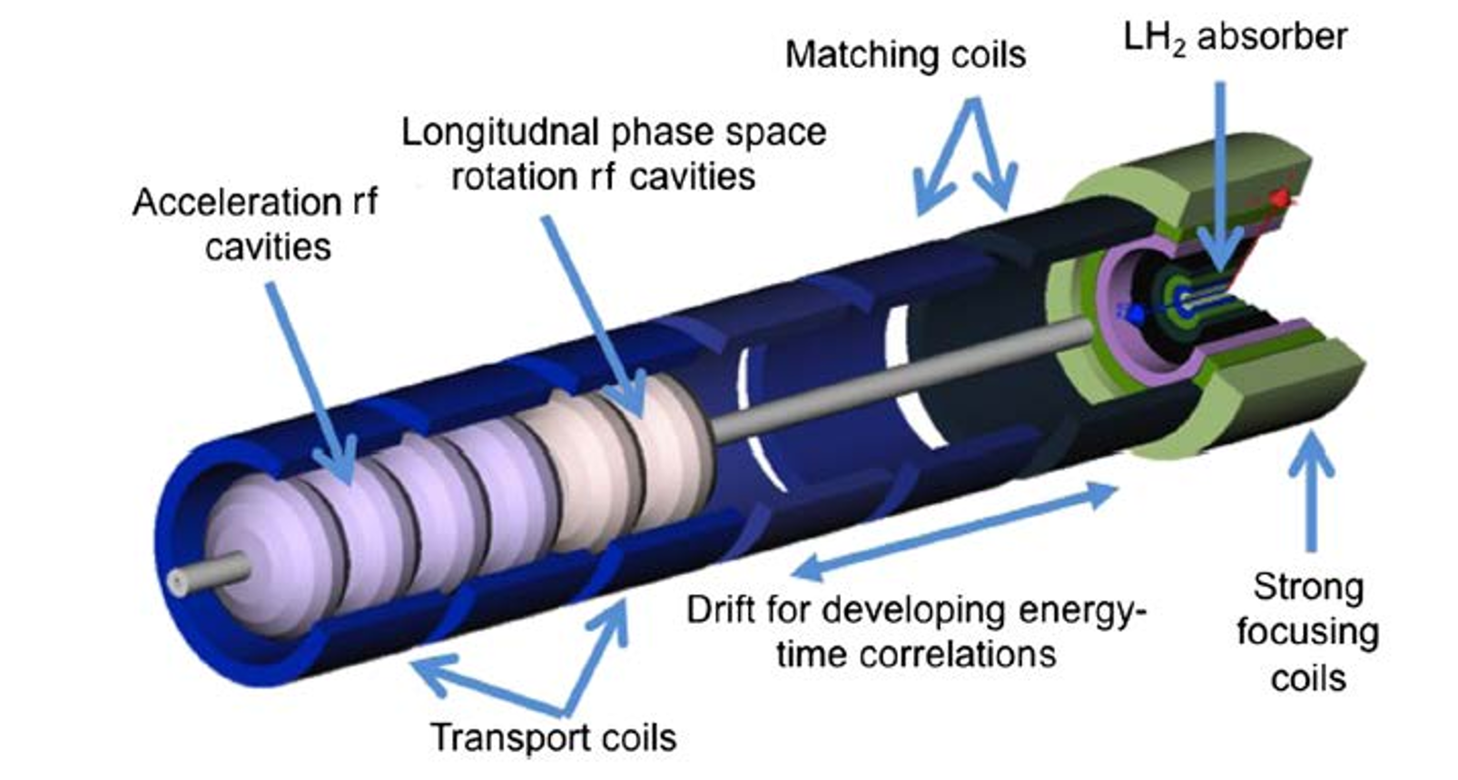
Ionization Cooling
Used because of short lifetime of muon
Beam passed through matter, loses energy through ionization
Momentum reduced in all axes (transverse and longitudinal)
Beam is then reaccelerated with RF cavity
Ends with greater proportion of momentum in longitudinal direction, achieving cooling

Slide 16
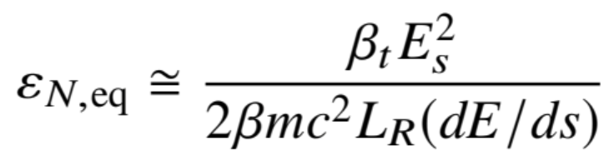
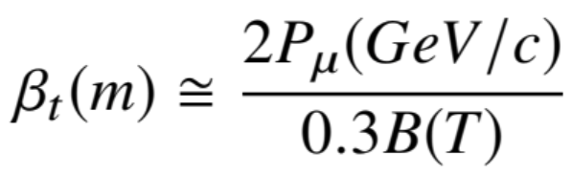
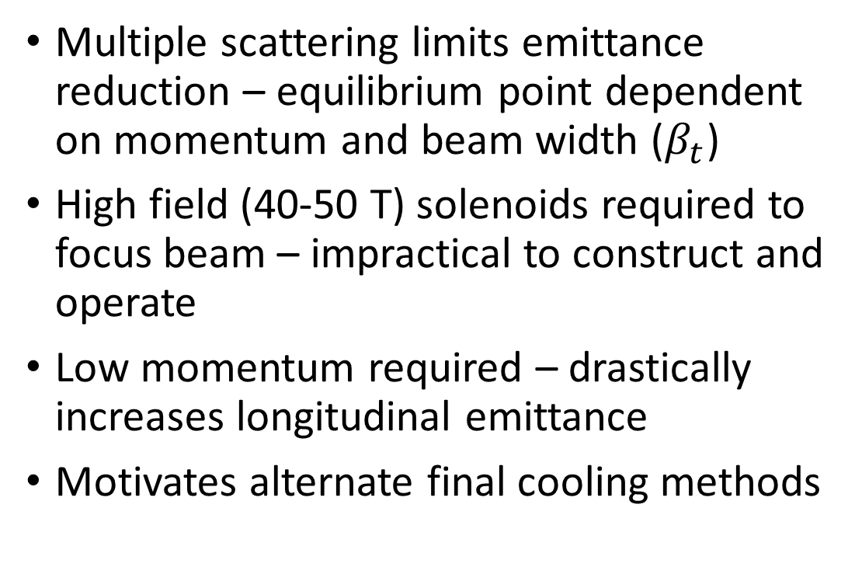
Problems with Baseline Final Cooling
Multiple scattering limits emittance reduction – equilibrium point dependent on momentum and beam width ($β_{t}$)
High field (40-50 T) solenoids required to focus beam – impractical to construct and operate
Low momentum required – drastically increases longitudinal emittance
Motivates alternate final cooling methods

Slide 17
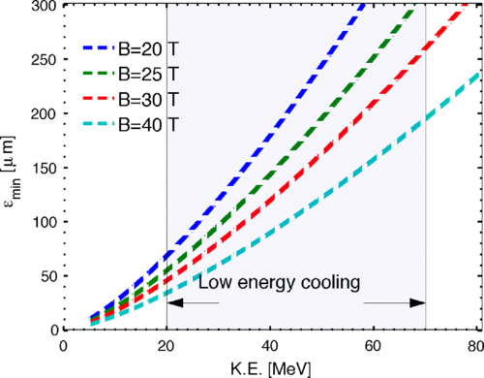
Problems with Baseline Final Cooling

Slide 18
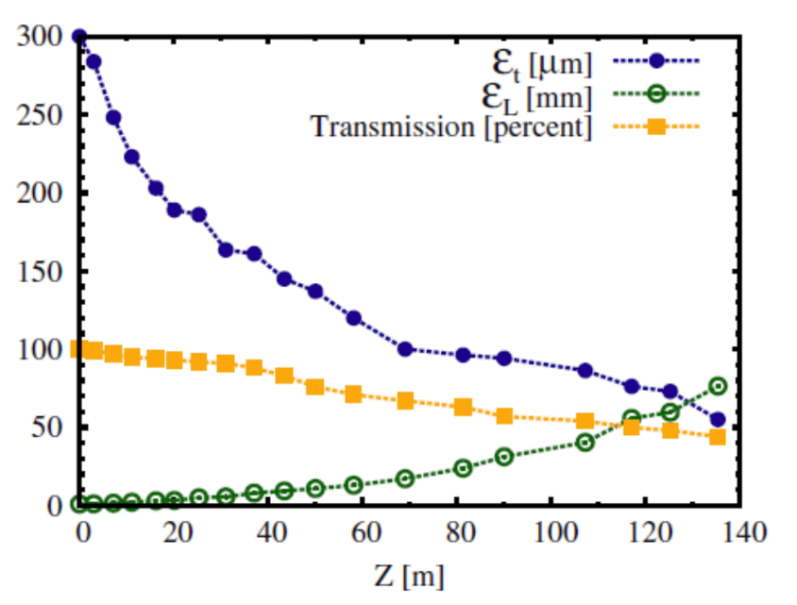
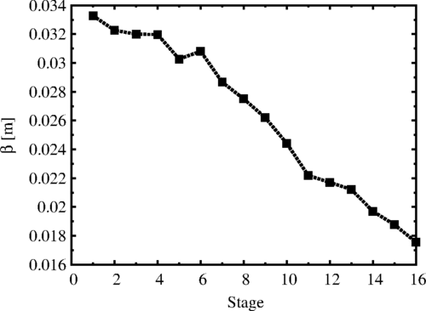
Baseline Graphs
Source: 1612.08960
Source: 10.1103

Slide 19
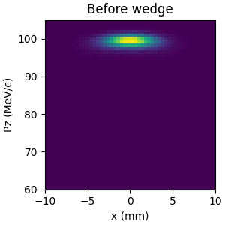
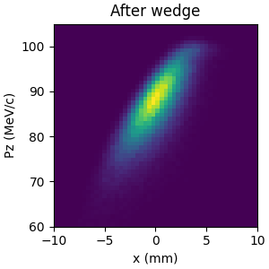
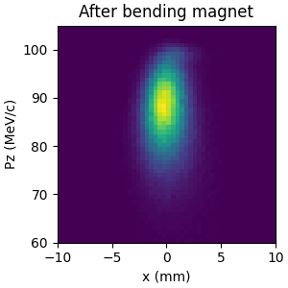
Wedge Cooling Mechanism

Slide 20
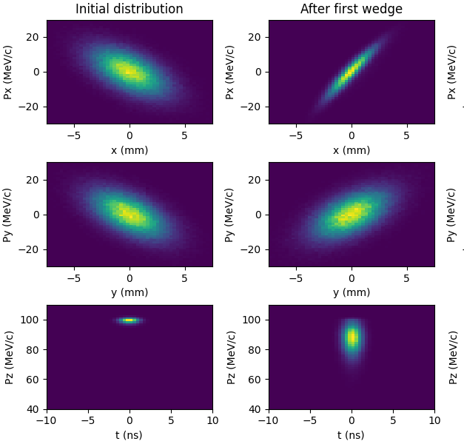
Wedge Cooling Mechanism
Emittance in axis of wedge (x) decreases
Emittance in second transverse axis (y) unchanged
Emittance in longitudinal (z) axis increases due to increased spread in momentum
Momentum spread must be reduced before second wedge

Slide 21
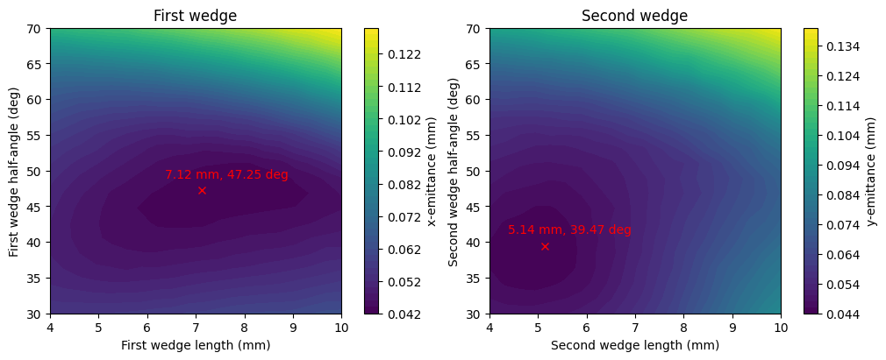
Simulation and Optimization
Simulated using G4Beamline software
Optimization conducted using Nelder-Mead method (scipy)
Optimized 1st wedge, drift length, RF cavity, and 2nd wedge sequentially
Left: Example G4Beamline simulation
Right: Optimal parameters for the first and second wedges

Slide 22
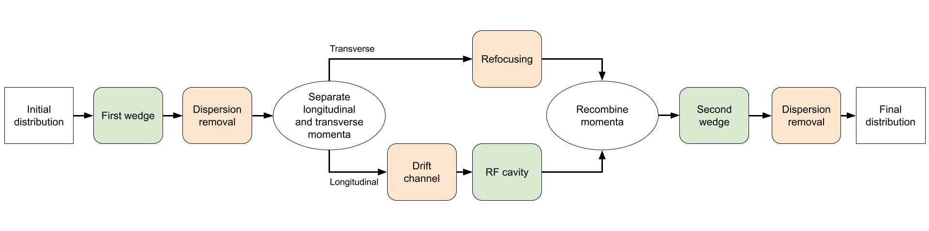
Caveats and Assumptions
Magnets for focusing, beam transport, and bending were not designed – idealized versions assumed
Required magnet strengths not precisely known
Only longitudinal behavior was considered in the RF cavity
Losses from muon decays and inter-particle interactions ignored
Green: Step simulated in G4Beamline
Orange: Step not simulated; assumptions made

Slide 23
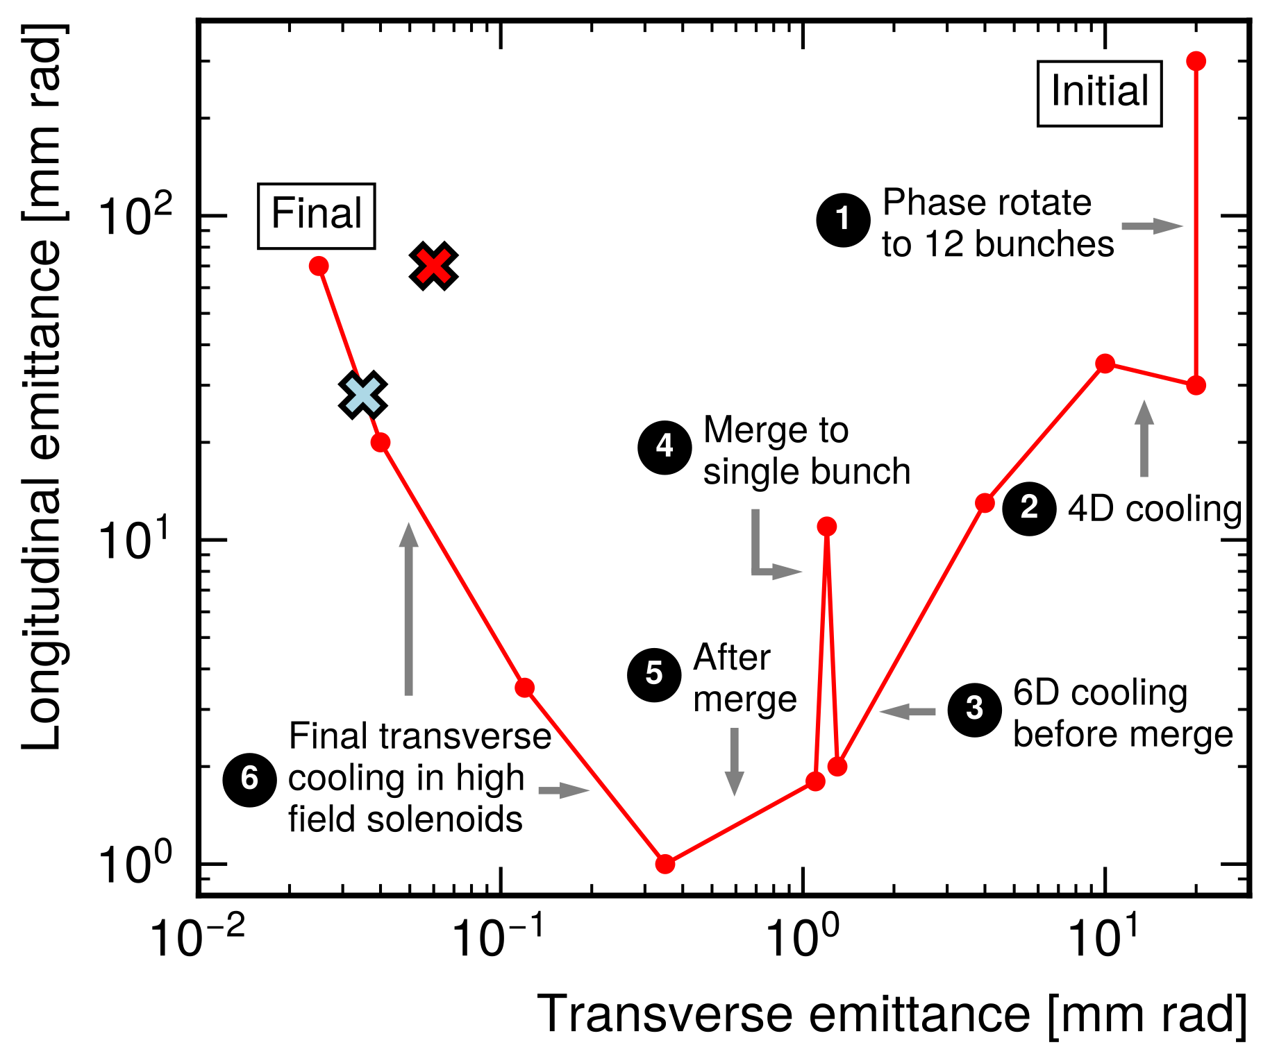
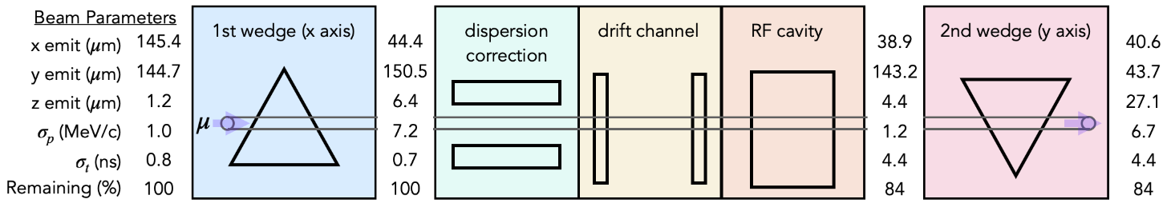
Summer 2023 Results
Optimized conceptual design
Achieved lower transverse emittance (x) than previous best results (x)
Demonstrated cooling from first and second wedges

